Slide 1
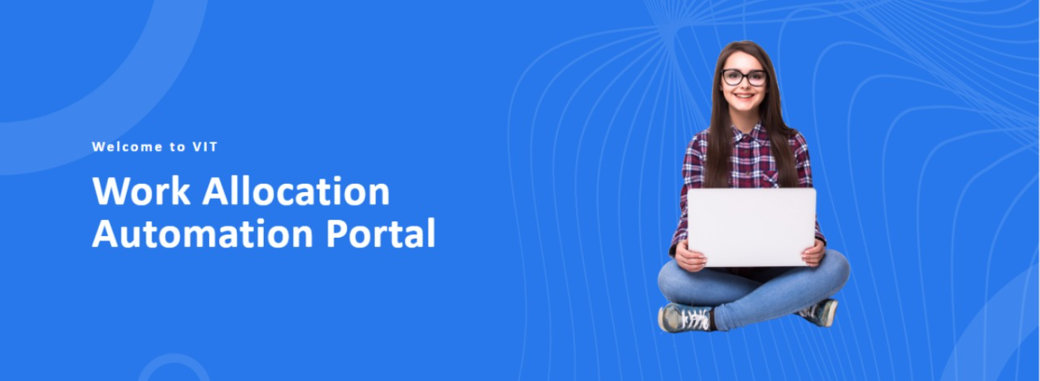
Webathon’22
Team Name: Flask
Team Members:
Adarsh Kumar Dubey (20BCE1422)
Raghav K (20BCE1468)
Spandan Ghosh (20BCE1428)

Slide 2
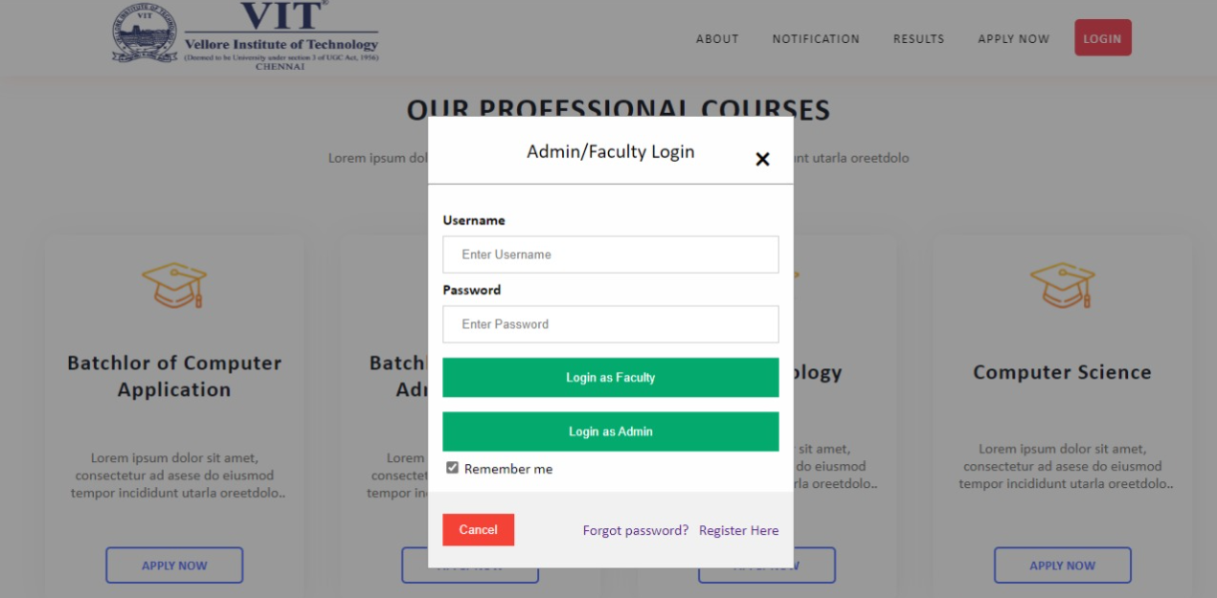
Admin or Faculty Login

Slide 3
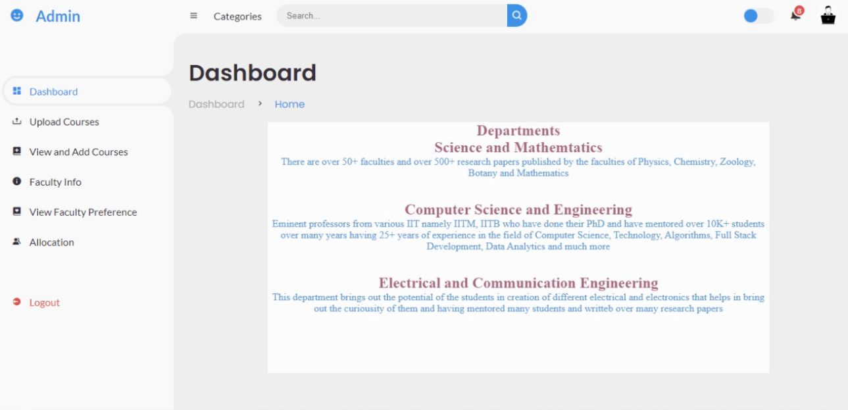
Dashboard

Slide 4
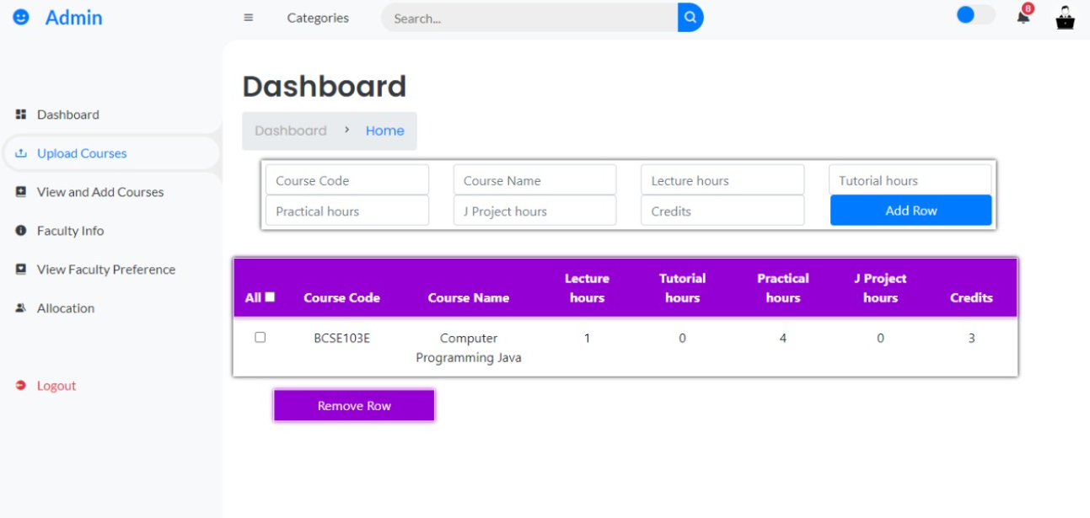
Dashboard

Slide 5
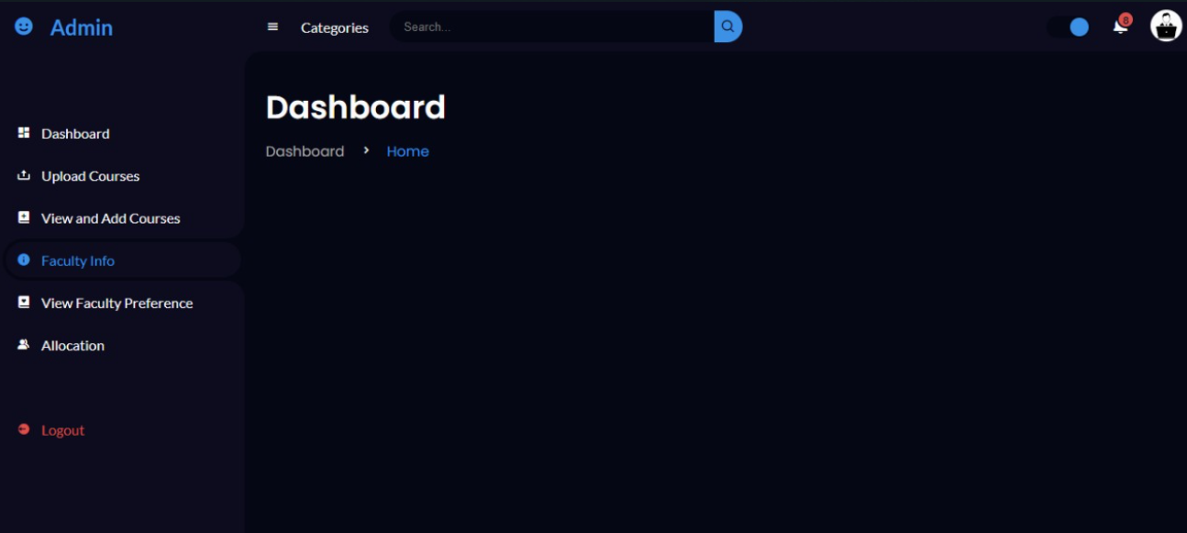
Dashboard can also be viewed in Dark Mode

Slide 6
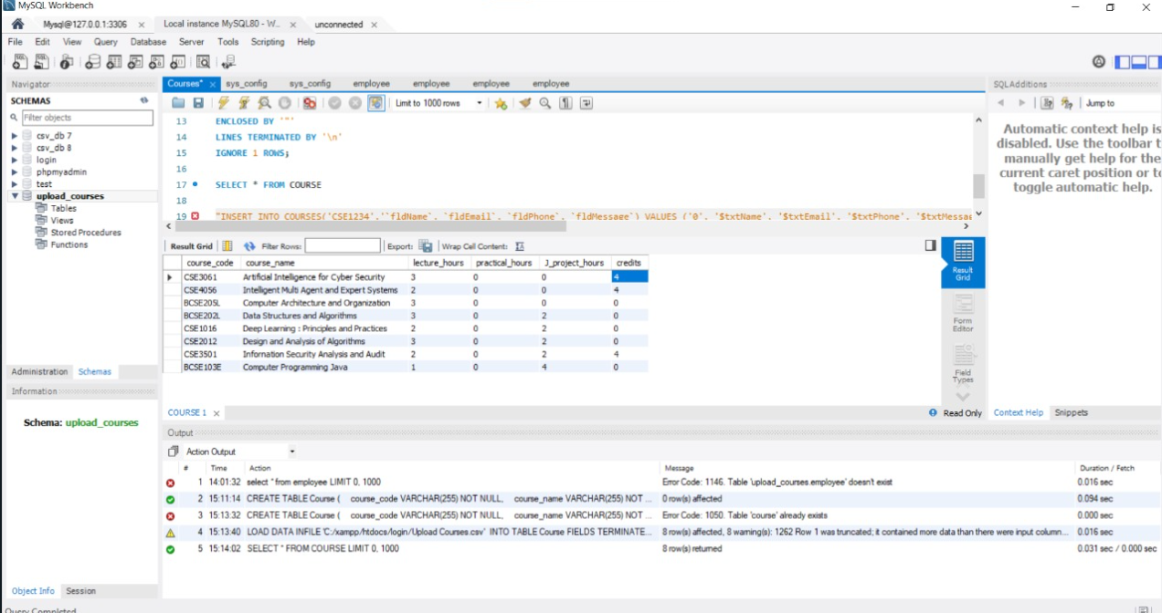
Backend

Slide 7


